Slide 1
Class 11_Static keyword in Java -Idea on Static variables,Methods

Slide 2
Java Primitive Data Types
There are 8 types of primitive data types:
boolean data type
byte data type
char data type
short data type
int data type
long data type
float data type
double data type

Slide 3
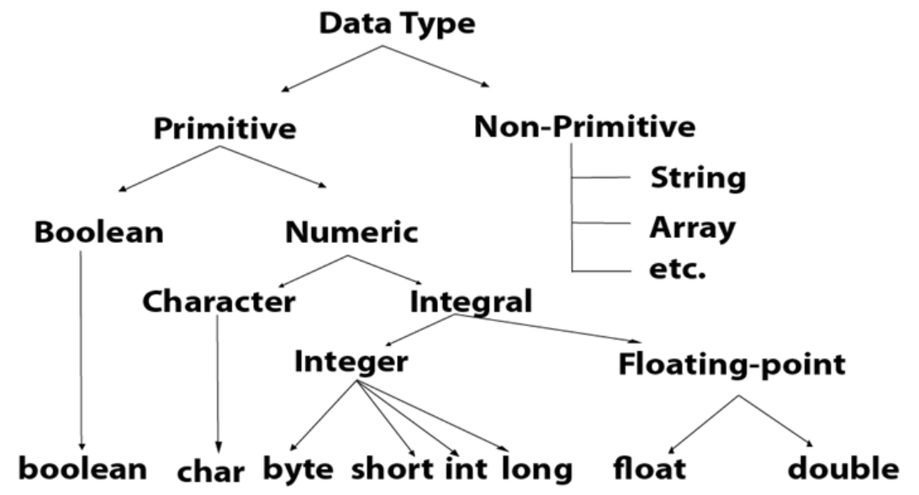
Data Types in Java

Slide 4
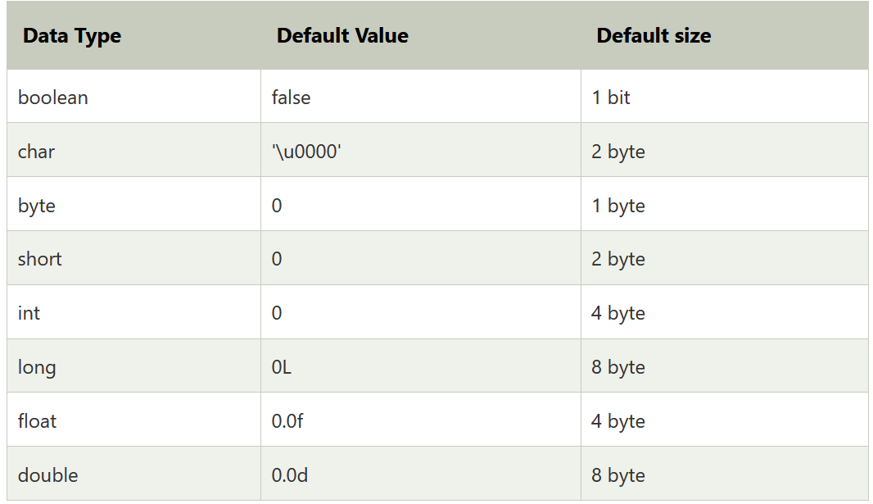
Data Types Size in Java

Slide 5
Boolean Data Types
The Boolean data type is used to store only two possible values: true and false. This data type is used for simple flags that track true/false conditions.
The Boolean data type specifies one bit of information, but its "size" can't be defined precisely.
Example:
Boolean one = false

Slide 6
Byte data type
Byte Data Type
The byte data type is an example of primitive data type. It isan 8-bit signed two's complement integer. Its value-range lies between -128 to 127 (inclusive). Its minimum value is -128 and maximum value is 127. Its default value is 0.
The byte data type is used to save memory in large arrays where the memory savings is most required. It saves space because a byte is 4 times smaller than an integer. It can also be used in place of "int" data type.
byte a = 10, byte b = -20

Slide 7
Short Data type
Short Data Type
The short data type is a 16-bit signed two's complement integer. Its value-range lies between -32,768 to 32,767 (inclusive). Its minimum value is -32,768 and maximum value is 32,767. Its default value is 0.
The short data type can also be used to save memory just like byte data type. A short data type is 2 times smaller than an integer.
short s = 10000, short r = -5000

Slide 8
Int Data Type
Int Data Type
The int data type is a 32-bit signed two's complement integer. Its value-range lies between - 2,147,483,648 (-2^31) to 2,147,483,647 (2^31 -1) (inclusive). Its minimum value is - 2,147,483,648and maximum value is 2,147,483,647. Its default value is 0.
The int data type is generally used as a default data type for integral values unless if there is no problem about memory.
int a = 100000, int b = -200000

Slide 9
Long Data Type
Long Data Type
The long data type is a 64-bit two's complement integer. Its value-range lies between
-9,223,372,036,854,775,808(-2^63) to 9,223,372,036,854,775,807(2^63 -1)(inclusive).
Its minimum value is - 9,223,372,036,854,775,808
and maximum value is 9,223,372,036,854,775,807. Its default value is 0. The long data type is used when you need a range of values more than those provided by int.
long a = 100000L, long b = -200000L

Slide 10
Float Data Type
Float Data Type
The float data type is a single-precision 32-bit IEEE 754 floating point.Its value range is unlimited. It is recommended to use a float (instead of double) if you need to save memory in large arrays of floating point numbers. The float data type should never be used for precise values, such as currency. Its default value is 0.0F.
float f1 = 234.5f

Slide 11
Double Data Type
Double Data Type
The double data type is a double-precision 64-bit IEEE 754 floating point. Its value range is unlimited. The double data type is generally used for decimal values just like float. The double data type also should never be used for precise values, such as currency. Its default value is 0.0d.
Example
double d1 = 12.3

Slide 12
Char Data Type
Char Data Type
The char data type is a single 16-bit Unicode character. Its value-range lies between '\u0000' (or 0) to '\uffff' (or 65,535 inclusive).The char data type is used to store characters.
char letterA = 'A'
Why char uses 2 byte in java and what is \u0000 ?
It is because java uses Unicode system not ASCII code system. The \u0000 is the lowest range of Unicode system. To get detail explanation about Unicode visit next page.

Slide 13
Unicode System
Unicode is a universal international standard character encoding that is capable of representing most of the world's written languages.
Why java uses Unicode System?
Before Unicode, there were many language standards:
ASCII (American Standard Code for Information Interchange) for the United States.
ISO 8859-1 for Western European Language.
KOI-8 for Russian.
GB18030 and BIG-5 for chinese, and so on.

Slide 14
Problem and Solutions with Unicode
Problem
This caused two problems:
A particular code value corresponds to different letters in the various language standards.
The encodings for languages with large character sets have variable length.Some common characters are encoded as single bytes, other require two or more byte.
Solution
To solve these problems, a new language standard was developed i.e. Unicode System.
In unicode, character holds 2 byte, so java also uses 2 byte for characters.
lowest value:\u0000
highest value:\uFFFF

